Slide 1
Getting Started with ASP.Net MVC
Tim Wingfield & Steve Horn
Notes:
Preview 2 came out in march.
New preview code drop came out on Thursday (4/17)
About me
Live in Hilliard, OH
Wife, two boys, and a black lab

Slide 2

Notes:
TIM - Love hockey, especially this guy…pay a lot to see him, at least.

Slide 3
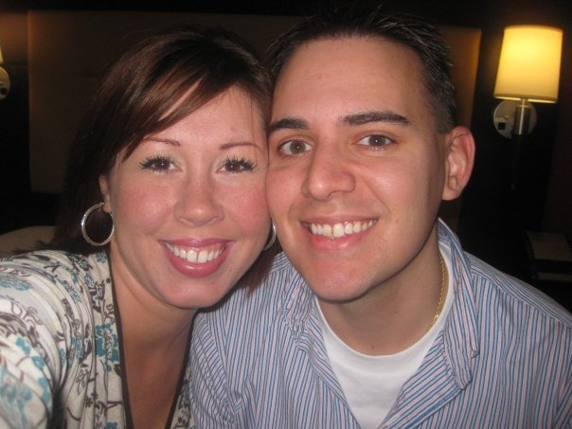

Notes:
STEVE
Married – 6 years.
Afton – 18 months, one on the way due in April.
Live in Columbus
Backpacking/hiking when possible.
Running – slacking lately.
Poker/cards/whatever

Slide 4



Notes:
TIM & STEVE
Professionally, I work for Quick Solutions, even though none of these people do.
Been with Quick for four years, all in the App Dev Group started by BHP.
Been developing for over 10 years, all in Columbus.
Also work for Quick, about 2.5 years.
Niche – user experience / user interaction design.
Web technologies.
Javscript / jQuery
Non profit stuff
Here today to share information on a framework I believe will benefit anyone who does web development in .Net.

Slide 5


!=
Notes:
TIM
“What are we trying to solve? What’s wrong with WebForms?”
WebForms tried to move WinForms to web development
Some developers think this is the way the whole web works
Introduced page event model (Lead in to event model)

Slide 6
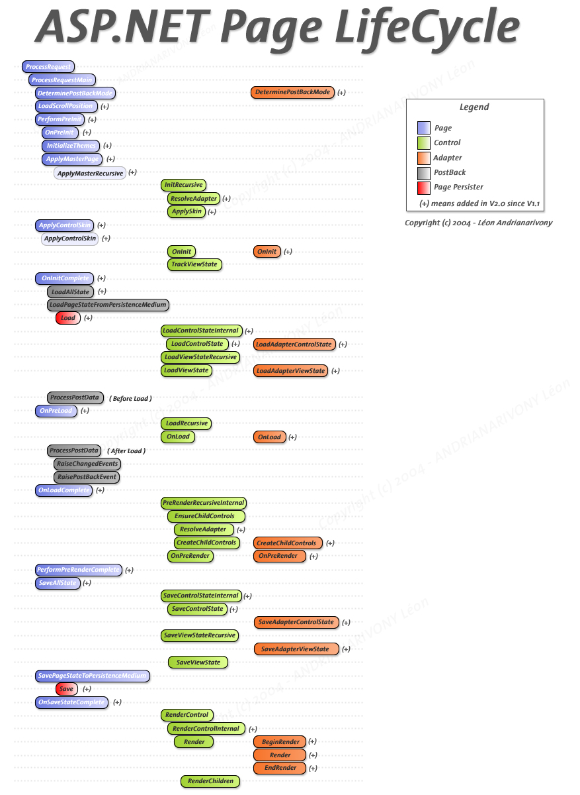
Notes:
STEVE
Some people say MVC is complicated?
Pre-init? Pre-load?
When does viewstate get loaded?
Tries to make a stateful form application.
- Viewstate
- Runat= Server (__doPostBack(….))
Server controls. (Know the abstraction and the limitation it is going to impose.)
Meaningless URLs – important to SEO and user friendliness.

Slide 7
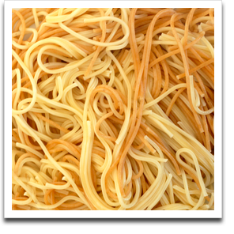
Page_Load(object sender, EventArgs e) { }
Notes:
TIM
The spaghetti of the page_load. (A steaming pile of Page_Load)
Neal Ford: “Bad developer will move heaven and Earth to do the wrong thing.”
Mix of presentation and logic in the code behind, no Separation of Concerns
Extremely difficult to test code behinds
Dependent on web server to run
Concrete classes on the web server run WebForms
No way to fake or mock those classes
Speaking Point: “So

Slide 8

Notes:
STEVE
Demand from community for an offering from Microsoft
Explain why monorail is a valid alternative, but it’s Open Source (Not from Microsoft)
MS solicited community. MvcContrib, etc.

Slide 9



Notes:
TIM

Slide 10



Notes:
TIM
PHP lists 35 different MVC implementations on Wikipedia
Up to 71 now

Slide 11



Notes:
TIM
Spring MVC, specifically

Slide 12


Notes:
TIM

Slide 13

Notes:
STEVE
New offering from Microsoft
Shared source project (similar to the AJAX Toolkit, which is the first I remember)
Expand on not a replacement to WebForms
- Alternative to WebForms
- WebForms not going away
- Not WebForms 4.0
It’s still ASP.Net – so you get to keep a lot of the framework.
-Forms auth
-Membership provider
-Caching
-Session
-Health monitoring (trace, etc.)

Slide 14
Model
View
Controller
Notes:
STEVE
Let’s talk about the design pattern.
Obligatory 3 circle diagram
Been around – for a while…before I was born. Smalltalk 1979
Separation of concerns…allows you to leverage OOP.
Controller should be tiny.

Slide 15

Notes:
TIM
Controller runs the show
It handles the request
Determines view
Determines data to load the view

Slide 16

Notes:
TIM
The view is only the presentation to the user
Any logic should only be presentation logic (check boxes checked, dropdowns set, etc)
asp.net version, view can be strongly typed to the model

Slide 17

Notes:
TIM
Model returns information as requested, doesn’t know to what view or what controller has called
Model everything that’s not view and controller – business logic, data, not just the db
Speaking point:
You’re thinking, “OK, great. So what? Why now?”

Slide 18

Request
Response
Notes:
TIM
Back to Requset and Response
Request comes in
Controller interprets the request and decides what to do
Application does something cool
Response is sent back to the Internets
No Postback
Page lifecycle still happens (look at trace)
Still based on asp.net

Slide 19

Notes:
STEVE
Encourage use of OOP principles
Separation of Concerns
Single Responsibilty
Dependencies are abstracted out to HttpContextBase, HttpRequestBase, etc
All Http classes now easily mocked
Could be done with webforms, but HttpContext was tied directly to IIS.

Slide 20

Notes:
STEVE
Views – HTML/CSS/Javascript are given the emphasis they deserve.
No more reaching around your elbow.
The way you write markup in visual studio is how it will be rendered.
Runat=server no longer needed
No business logic in the view…watch out if you have ifs or loops.
Use of CSS easier
Notice return of “Classic ASP” type code. Think of them as templates.

Slide 21

Notes:
STEVE
Webforms maps a path to a physical file on the hard drive.
Routes a url to a class and method in your code.
Clean URLs
No file extensions – implementation details
REST – based around “Resources” – turn your web app into an API (Think Twitter)
Originally part of mvc namespace, has been moved “up” to web namespace
Map a webforms page to a route – the user will never know the difference. Good for one offs where webforms model fits better.

Slide 22

Notes:
TIM
Lower maintenance over time.
Views handle one specific need.
Controller code much more concise than the event driven code behinds.

Slide 23
MvcContrib.org
Notes:
STEVE
Open source project on CodePlex
Adding code for MVC to work with Castle, Spring.Net, Structure Map, etc.
Fluent Html – similar to <asp:Textbox, etc.
Side-by-side with the MVC project since inception
Original HtmlHelpers folded into release 2, MvcContrib picking up where they left off
Warning: Requires Microsoft.Web.Mvc in addition to the regular MVC dll

Slide 24

Web Forms are Dead!
Long Live Web Forms!
Notes:
TIM
Much more mature framework to build ASP.Net apps on
Quicker deployment, more drag and drop
More Better UI controls available.
Lots of 3rd party controls available…like our Friends at Telerik
Better Documentation
More examples and code samples to draw from
And, of course, the update panel!

Slide 25
<code />
Notes:
Fluent nHibernate
SQLite3
Inversion of control
Not perfect “One model in, one model out” design…but close
Partial views if we get time

Slide 26
Resources
www.asp.net/mvc/
www.hanselman.com/blog/
www.haacked.com
weblogs.asp.net/scottgu/

Slide 27
Tim Wingfield email: tim@timwingfield.com blog: blog.timwingfield.com twitter: timwingfield
Steve Horn
email: steve@stevehorn.cc blog: blog.stevehorn.cc twitter: stevehorn
code: www.codeincubator.com

